Slide 1
Chapter 10
EXCEPTION HANDLING
Copyright © 2013 by The McGraw-Hill Companies, Inc. All rights reserved.

Slide 2
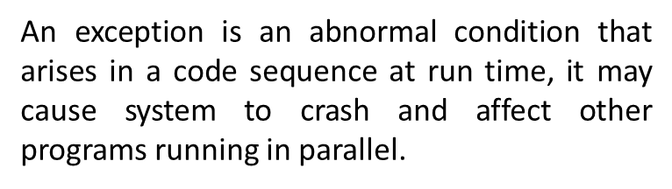
Exception
How is an Exception represented in Java?

Slide 3
A Java exception is an object that describes an exceptional (that is, error) condition that has occurred in a piece of code
When an exceptional condition arises, an object representing that exception is created and thrown in the method that caused the error
That method may choose to
a) handle itself
or
b) pass it on.
At some point, the exception is caught and processed

Slide 4
The Exception Hierarchy
In Java, all exceptions are represented by classes. All exception classes are derived from a class called Throwable. Thus, when an exception occurs in a program, an object of some type of exception class is generated.
There are two direct subclasses of Throwable: Exception and Error.
Exceptions of type Error:
Errors that occur in the Java virtual machine itself, and not in the program.
Beyond the user control, and the program will not usually deal with them.
Errors that result from program activity are represented by subclasses of Exception.
For example, divide-by-zero, array boundary, and file errors fall into this category. The program should handle exceptions of these types. An important subclass of Exception is RuntimeException, which is used to represent various common types of run-time errors.

Slide 5
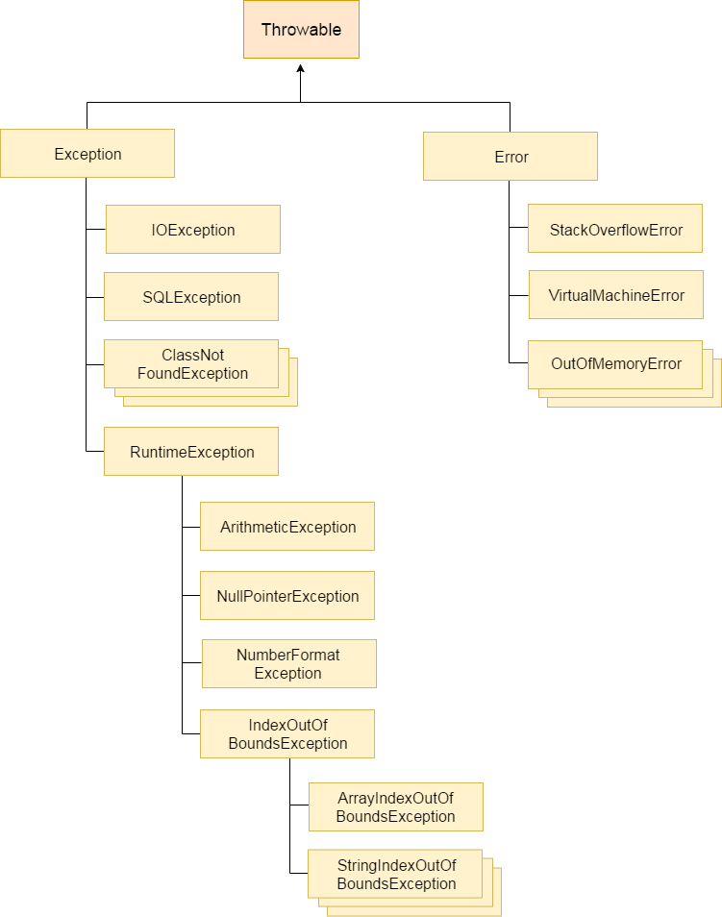

Slide 6
Exception Handling Fundamentals
Java exception handling is managed via five keywords:
try, catch, throw, throws, and finally

Slide 7
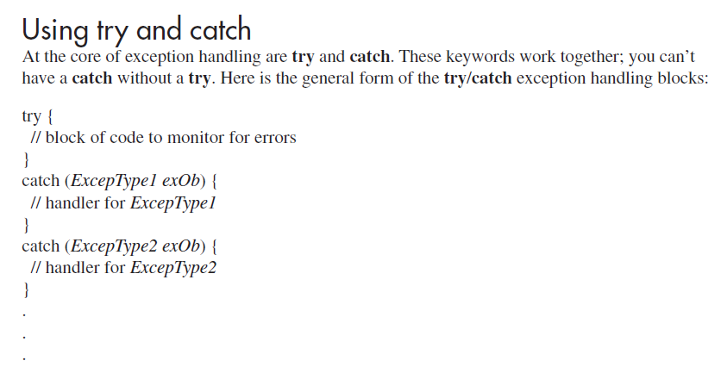

Slide 8
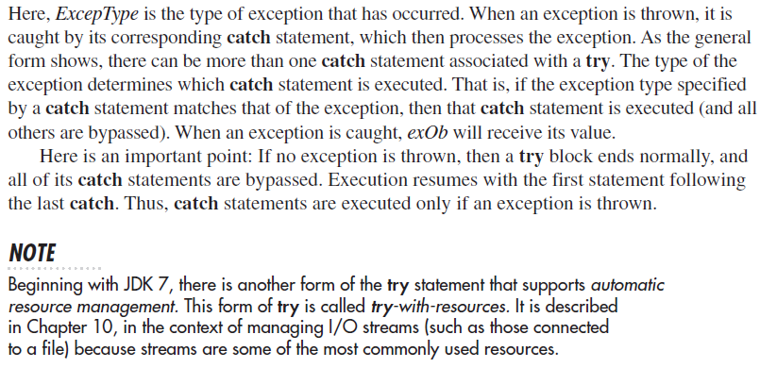

Slide 9
A Simple Exception Example
Using
try and catch blocks

Slide 10

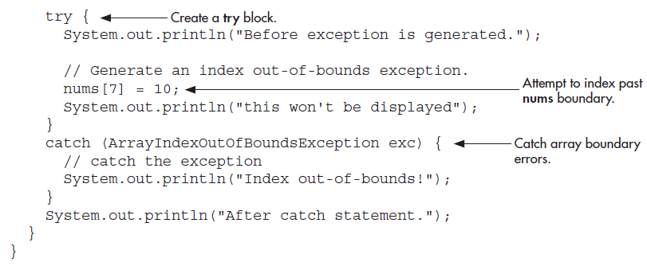

Slide 11
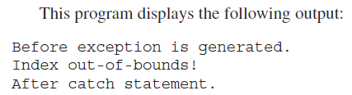
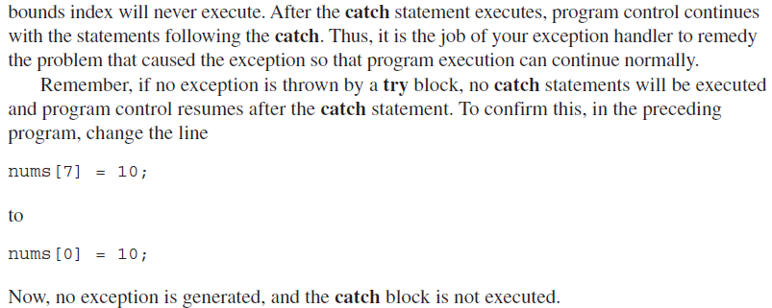

Slide 12

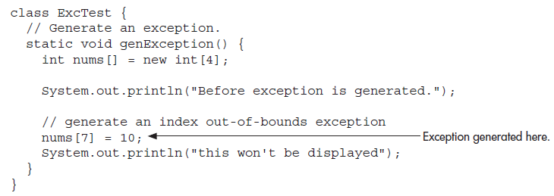

Slide 13
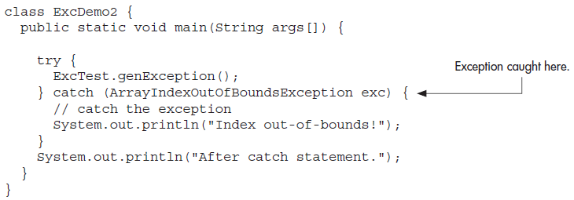


Slide 14
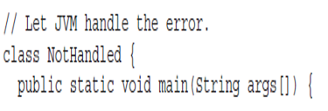
The Consequences of an Uncaught Exception
If your program does not catch an exception, then it will be caught by the JVM. The JVM’s default exception handler terminates execution and displays a stack trace and error message

Slide 15
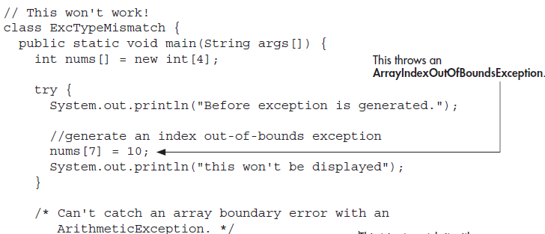

Slide 16
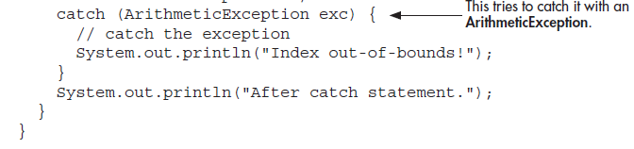
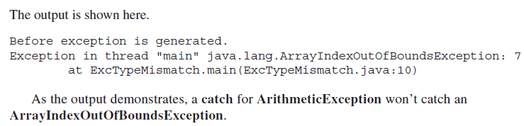

Slide 17
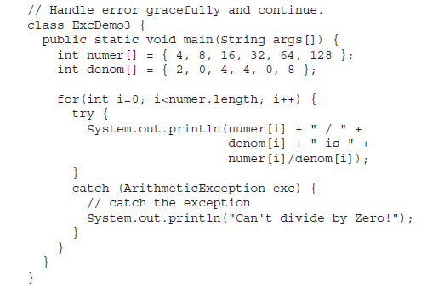
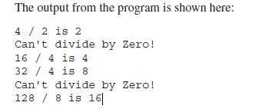
Exceptions Enable You to Handle Errors Gracefully

Slide 18
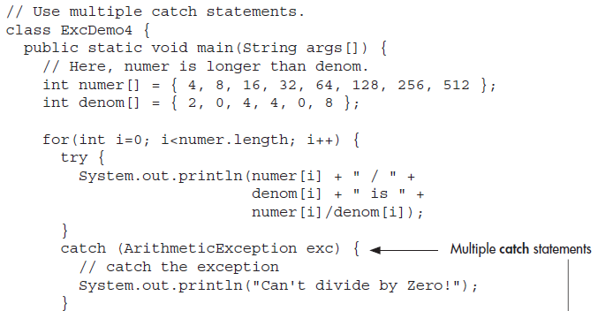
Using Multiple catch Statements

Slide 19
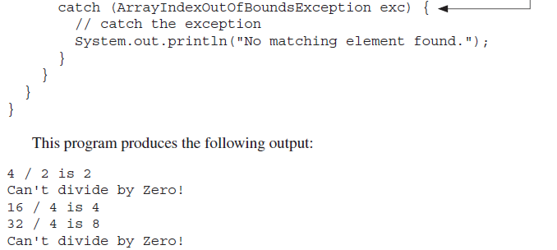


Slide 20
Progress Check
Does the exception type in a catch clause matter?
What happens if an exception is not caught?
When an exception occurs, what should your program do?

Slide 21
Catching Subclass Exceptions
If you want to catch exceptions of both a superclass type and a subclass type, put the subclass first in the catch sequence.
Putting the superclass first causes unreachable code to be created, since the subclass catch clause can never execute

Slide 22
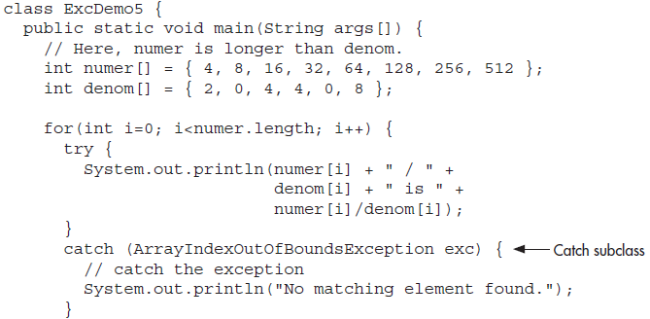

Slide 23
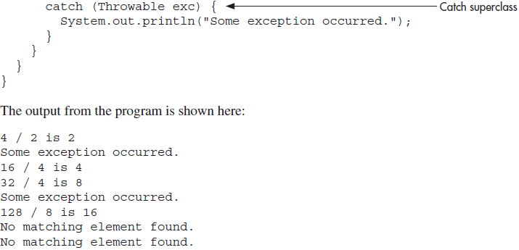

Slide 25
Try Blocks Can Be Nested

Slide 26
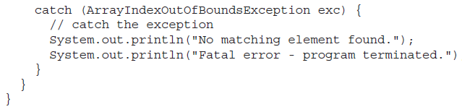

Slide 27
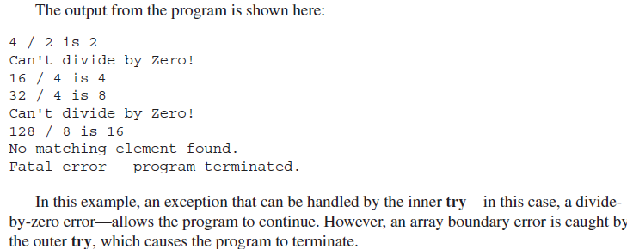

Slide 28
Progress Check
Can one try block be used to handle two or more different types of exceptions?
Can a catch for a superclass exception also catch subclasses of that superclass?
In nested try blocks, what happens to an exception that is not caught by the inner block?

Slide 29
Throwing an Exception
It is possible to manually throw an exception by using the throw statement. Its general form is shown here:
throw exceptOb;
Here, exceptOb must be an object of an exception class derived from Throwable.
Here is an example that illustrates the throw statement by manually throwing an ArithmeticException:

Slide 30
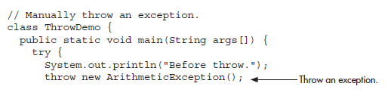
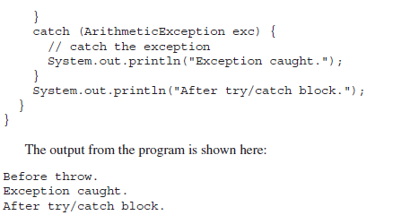
throw Demo

Slide 31
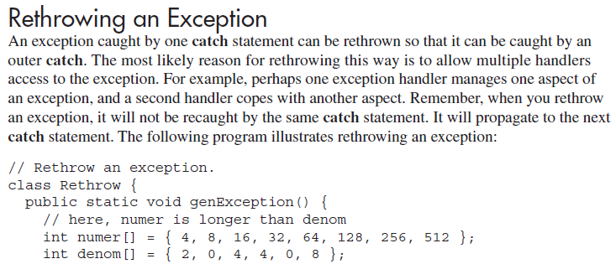

Slide 32
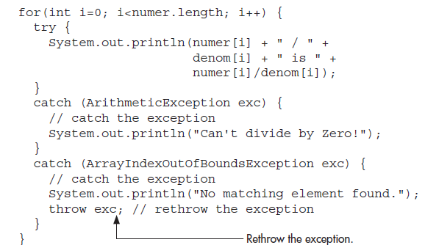

Slide 33
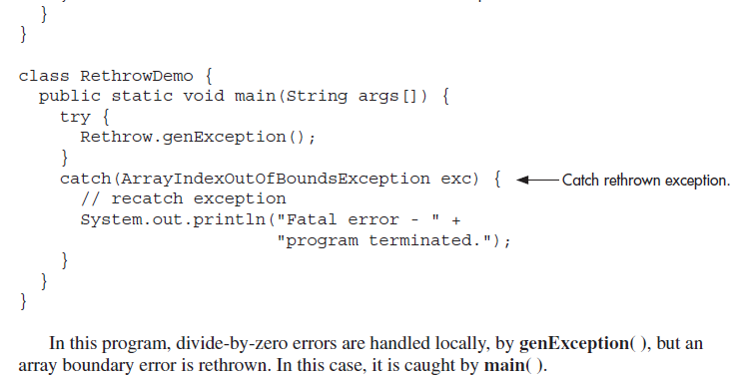

Slide 34
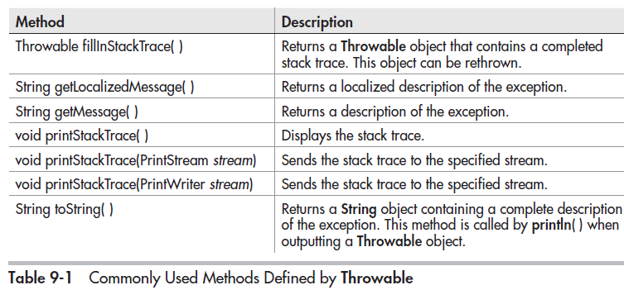

Slide 35
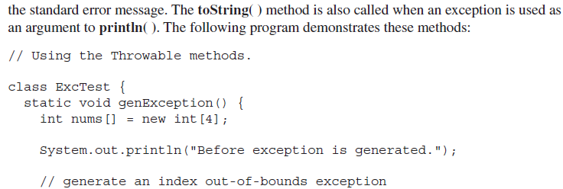

Slide 36
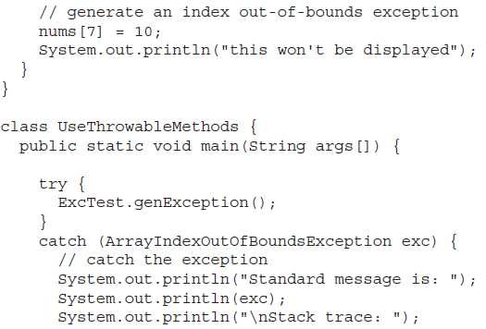

Slide 37
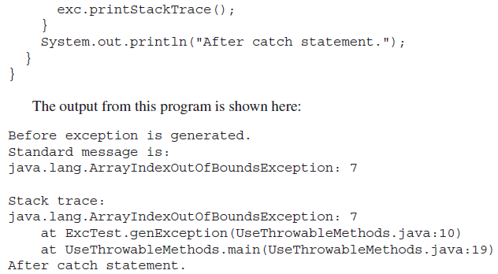

Slide 38
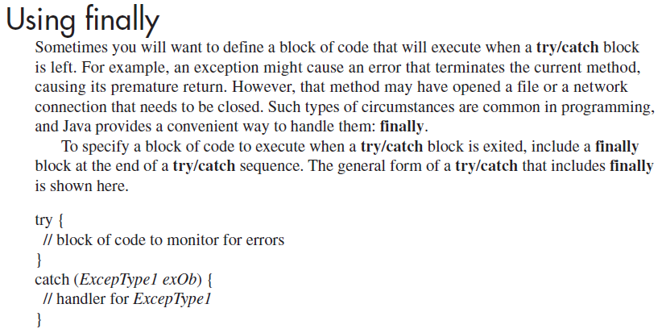
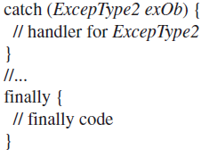

Slide 39
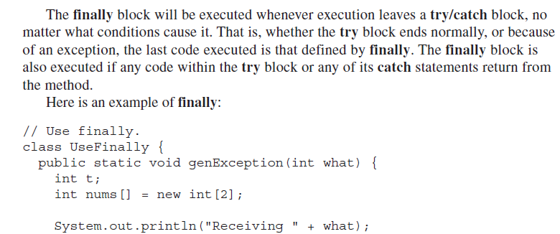

Slide 40
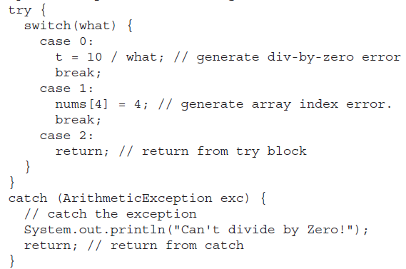

Slide 41
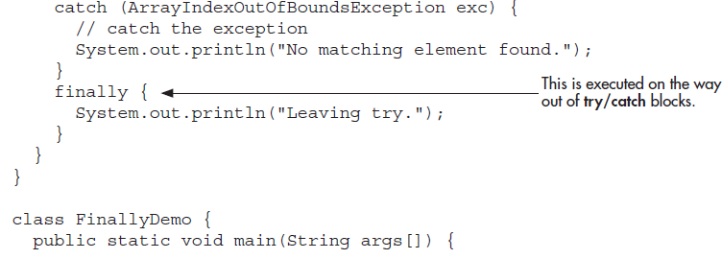
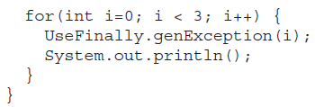

Slide 42
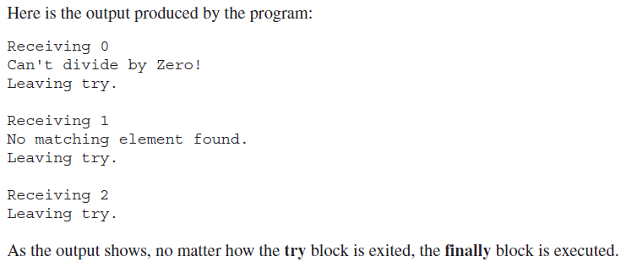

Slide 43
Progress Check
Exception classes are subclasses of what class?
When is the code within a finally block executed?
How can you display a stack trace of the events leading up to an exception?

Slide 44
Using throws
In some cases, if a method generates an exception that it does not handle, it must declare that exception in a throws clause. Here is the general form of a method that includes a throws clause:
ret-type methName(param-list) throws except-list { // body }
Here, except-list is a comma-separated list of exceptions that the method might throw outside of itself.
Exceptions that are subclasses of Error or RuntimeException don’t need to be specified in a throws list. Java simply assumes that a method may throw one. All other types of exceptions do need to be declared. Failure to do so causes a compile-time error.

Slide 45
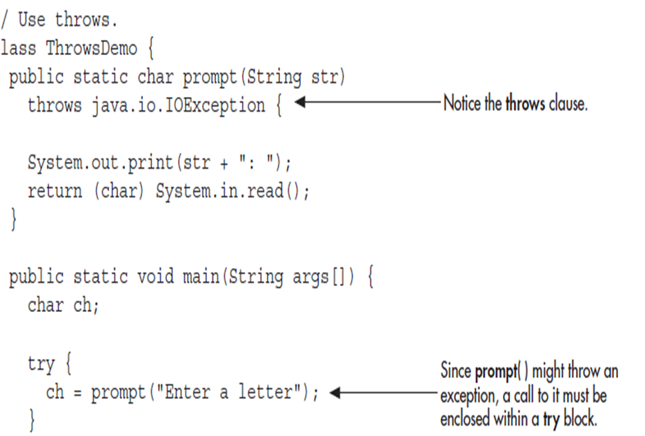

Slide 46
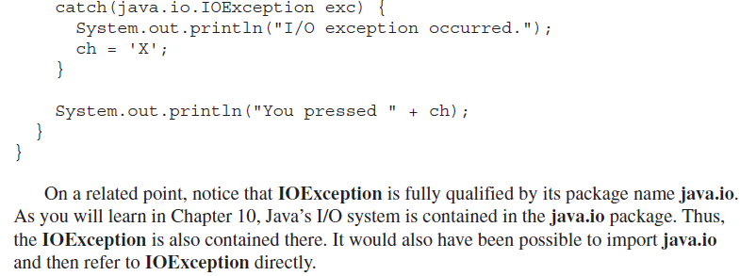

Slide 47
Three Recently Added Exception Features
The first supports automatic resource management, which automates the process of releasing a resource, such as a file, when it is no longer needed. It is based on an expanded form of try, called the try-with-resources statement.
The second is multi-catch allows two or more exceptions to be caught by the same catch clause.
The third is
final rethrow or more precise rethrow

Slide 48
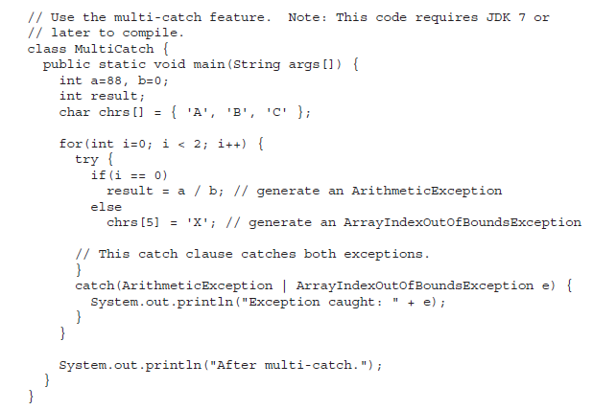
Multi catch

Slide 49
More precise rethrow
The more precise rethrow feature restricts the type of exceptions that can be rethrown to only those checked exceptions that the associated try block throws, that are not handled by a preceding catch clause, and that are a subtype or supertype of the parameter.

Slide 50
Java’s Built-in Exceptions
Unchecked exceptions:
The compiler does not check to see if a method handles or throws these exceptions.
They need not be included in any method’s throws list
Checked exceptions:
Must be included in a method’s throws list if that method can generate one of these exceptions and does not handle it itself.

Slide 51
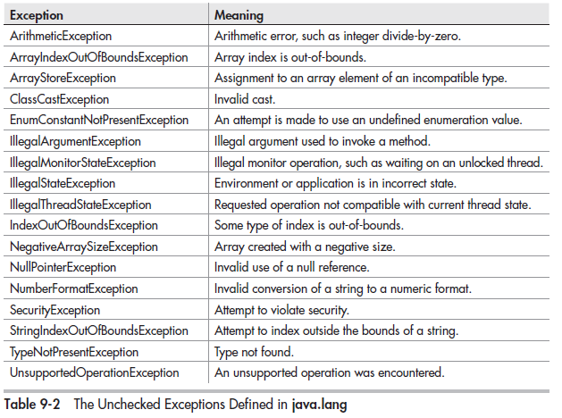

Slide 52
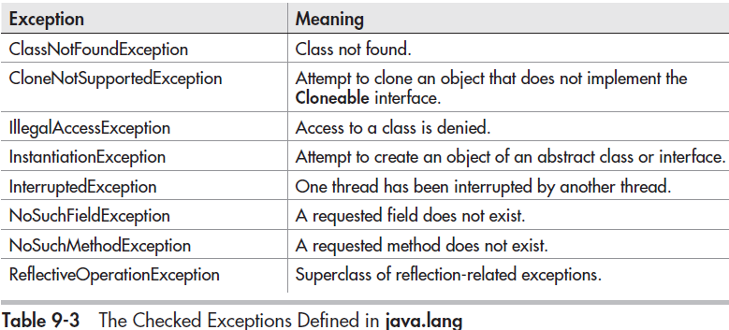

Slide 53
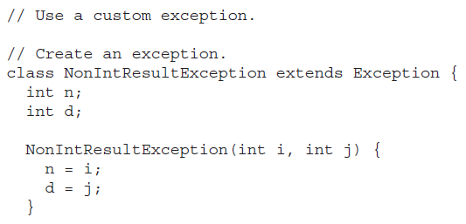
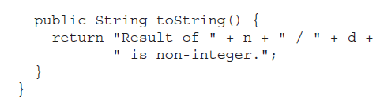
Creating Exception Subclasses

Slide 54
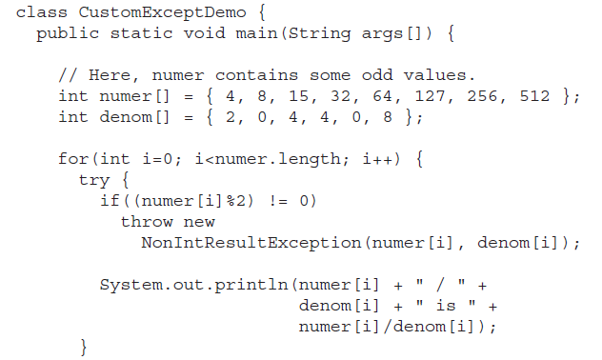

Slide 55
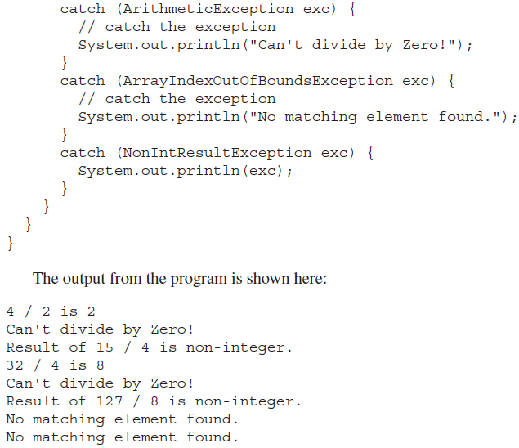

Slide 56
Questions
What class is at the top of the exception hierarchy?
What are checked and unchecked exceptions?
Differentiate between throw and throws keywords.
What is the significance of finally keyword? Explain.

Slide 57
Exercises
What is wrong with this fragment?
//…….
Vals[18] = 10;
catch(ArrayIndexOutOfBoundsException e){…}
What is wrong with this fragment?
class A extends Exception{……
class B extends A {………
//……
try{
//…….
}
catch(A exec) {…..}
catch(B exec) {…..}

Slide 58
Exercises
What is wrong with this fragment?
class MyClass { // ……}
// …….
Throw new MyClass();

